Slide 1
CHAPTER 6
Orthogonality and Least Squares

Slide 2
Chapter 6 Orthogonality and Least Squares
§ 6.1 Inner Product, Length and Orthogonality
§ 6.2 Orthogonal Sets
§ 6.3 Orthogonal Projections
§ 6.4 The Gram – Schmidt Process
§ 6.5 Least – Squares Problems

Slide 3
§6.1 Inner Product, Length and Orthogonality
1. The Inner Product
2. The Length of a Vector
3. Distance in R^{n}
4. Orthogonal Vector
5. Orthogonal Complements

Slide 4
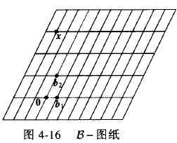
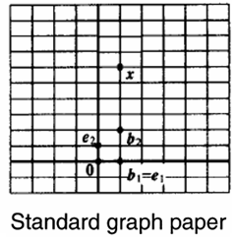

Coordinate System

Slide 5
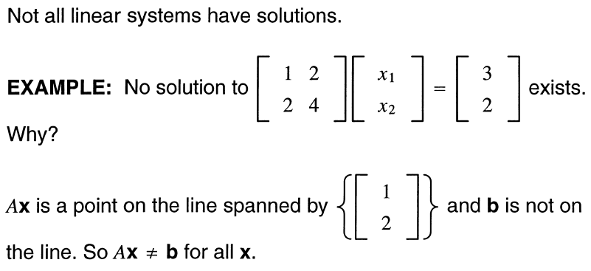
§6.1 Inner Product, Length and Orthogonality
1. The Inner Product

Slide 6
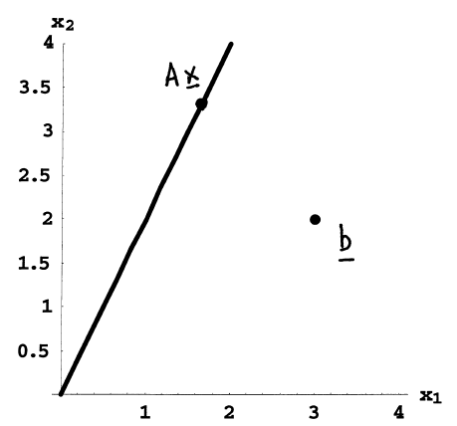

Slide 7
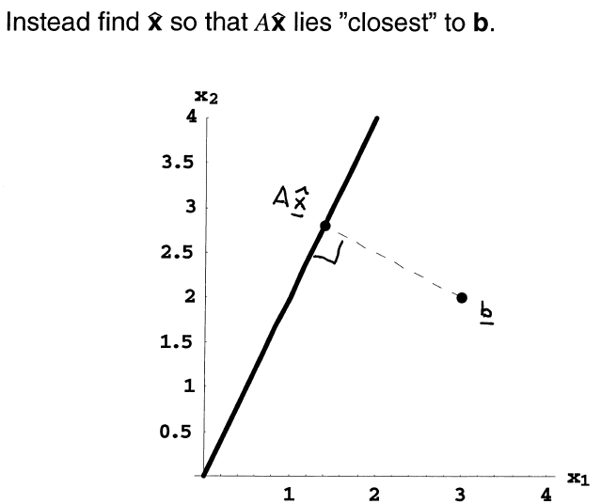

Slide 8
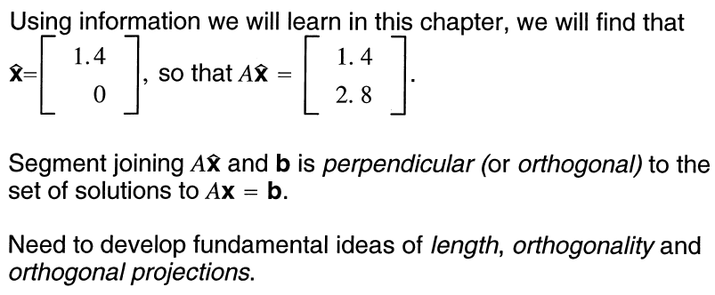

Slide 9
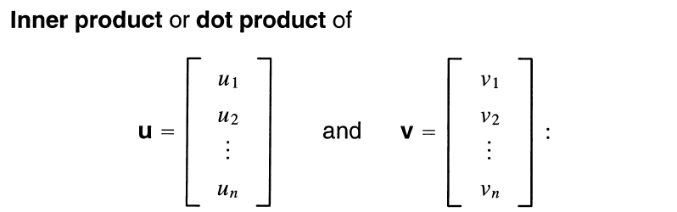
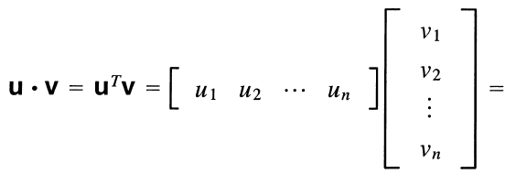



§6.1 Inner Product, Length and Orthogonality
1. The Inner Product

Slide 10

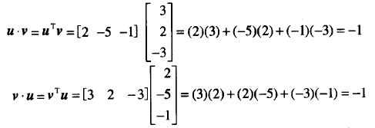
Example：
Solution：

Slide 11
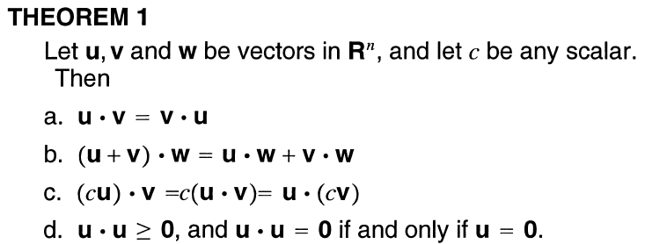
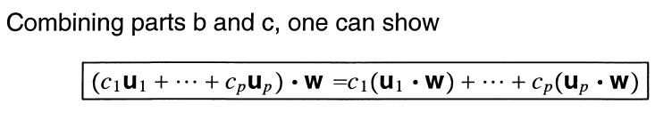
§6.1 Inner Product, Length and Orthogonality

Slide 12
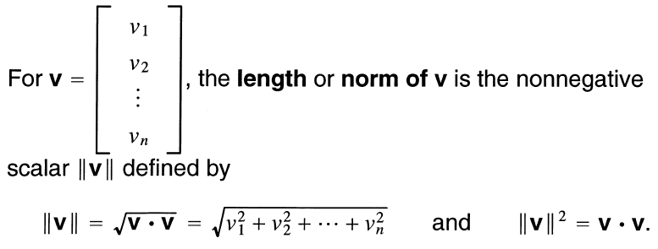

§6.1 Inner Product, Length and Orthogonality
2. The Length of a Vector

Slide 13
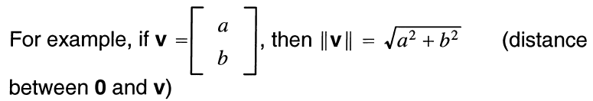
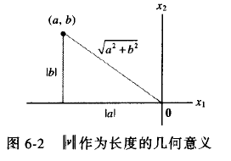

Slide 14

§6.1 Inner Product, Length and Orthogonality
Unit vector: A vector whose length is 1 is called a unit vector.
Normalizing: If a nonzero vector v is divided by its length ( or multiply by ), a unit vector u can be obtained. This process is called normalizing.

Slide 15


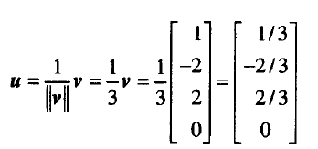

Example：
Let
Find a unit vector u in the same
direction as v.
Solution： First, compute the length of v:
multiply by
to obtain
To check that ||u||=1, it suffices that ||u||²=1

Slide 16
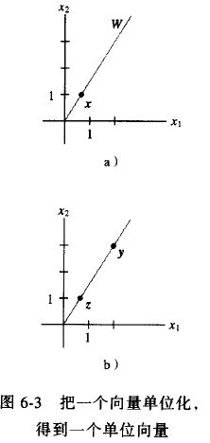
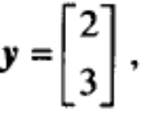


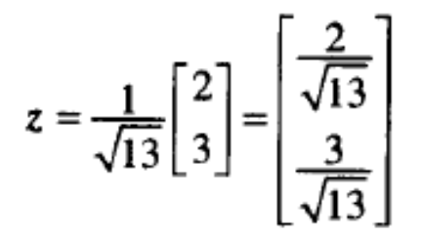

§6.1 Inner Product, Length and Orthogonality
Example ：let W be the subspace of R² spanned by x=(2/3, 1). Find a unit vector z that is a basis for W.
Solution: W consists of all multiples of x. Any nonzero vector in W is a basis for W. Multiply x by 3 to get
Now compute
And normalize to get
Another unit vector is

Slide 17
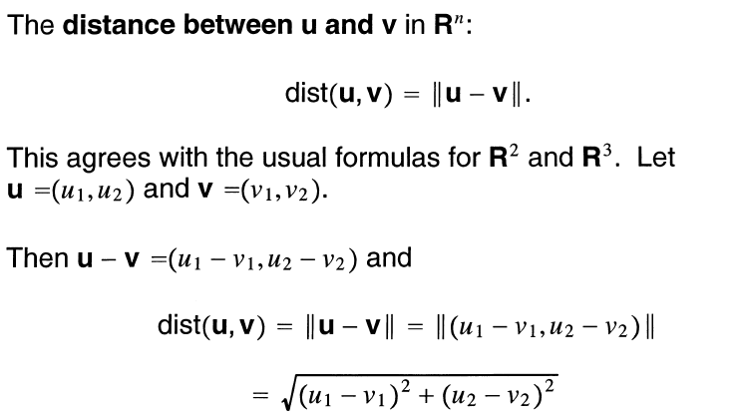
§6.1 Inner Product, Length and Orthogonality
3. Distance in R^{n}

Slide 18


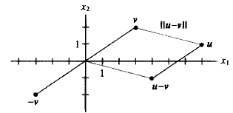
§6.1 Inner Product, Length and Orthogonality
Example：Compute the distance between the vectors
u=(7,1) and v=(3,2).
Solution: Compute
So

Slide 19
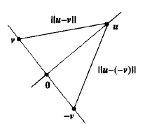
§6.1 Inner Product, Length and Orthogonality
4. Orthogonal Vector
Consider R² or R³ and two lines through the origin determined by vectors u and v. The two lines are geometrically perpendicular (几何上的垂直) if and only if the distance from u to v is the same as the distance from u to –v.

Slide 20
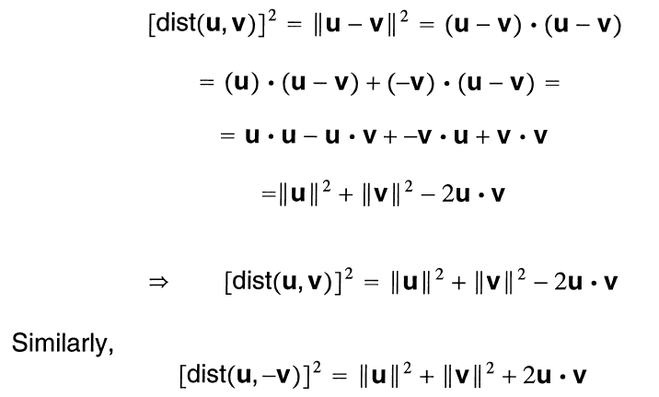

Slide 21
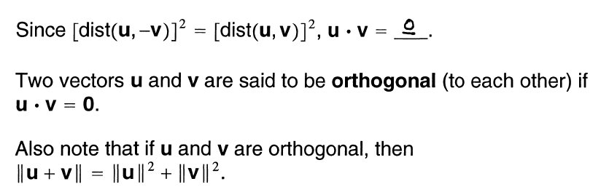
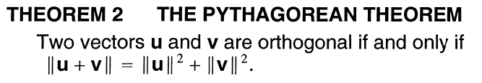

Slide 22
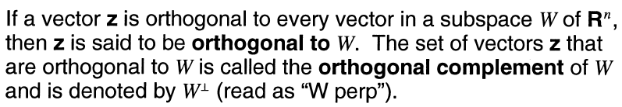
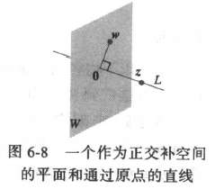
§6.1 Inner Product, Length and Orthogonality
5. Orthogonal Complements

Slide 23
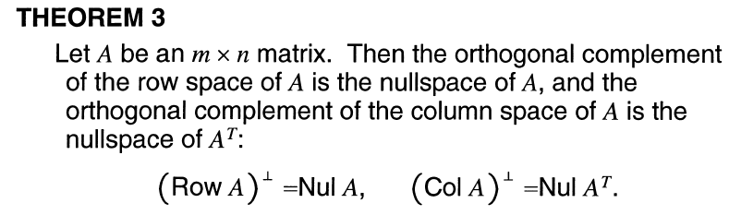
§6.1 Inner Product, Length and Orthogonality
The two facts about
A vector x is in W⊥ if and only if x is orthogonal to every vector in a set that spans W.
W⊥ is a subspace of R^{n}.

Slide 24
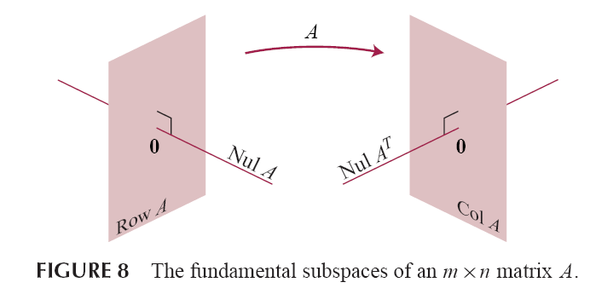
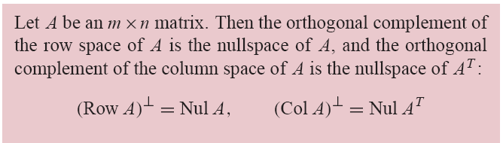

Slide 25
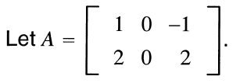

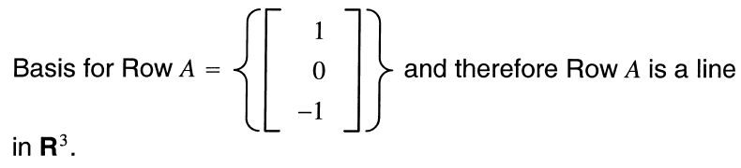
Example
Then

Slide 26
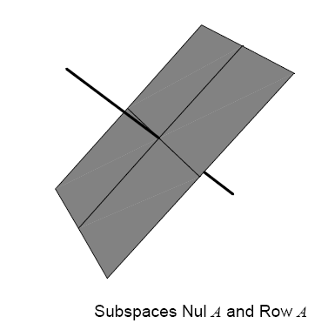
§6.1 Inner Product, Length and Orthogonality

Slide 27
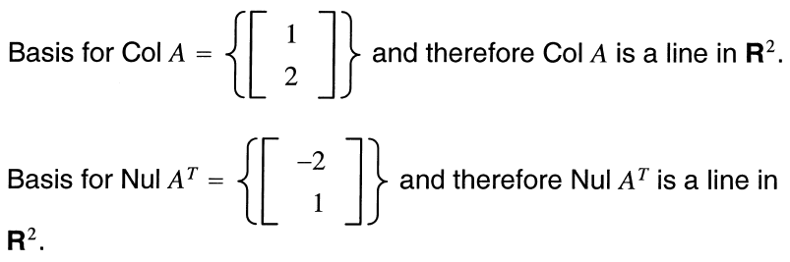
§6.1 Inner Product, Length and Orthogonality

Slide 28
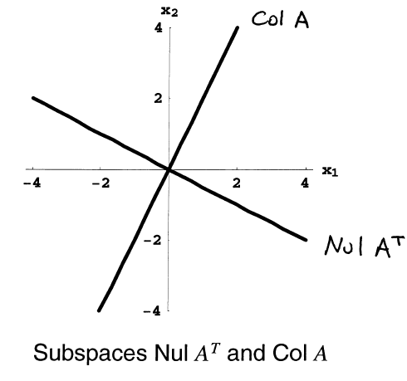

Slide 29
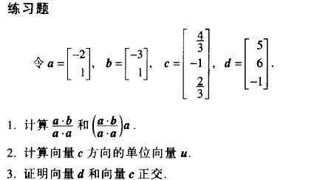
§6.1 Inner Product, Length and Orthogonality

Slide 30
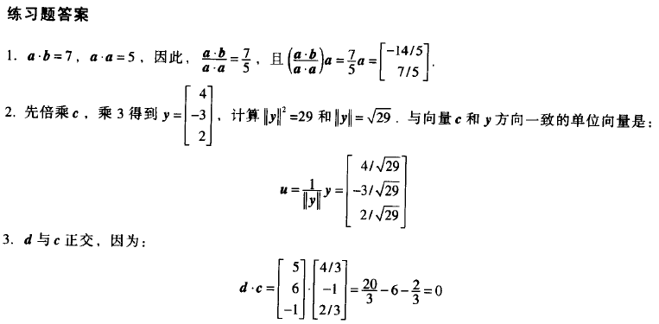
§6.1 Inner Product, Length and Orthogonality

Slide 31
§6.2 Orthogonal Sets
1. Orthogonal Sets (正交集)
2. An Orthogonal Projection
3. Orthonormal Sets (单位正交集)

Slide 32

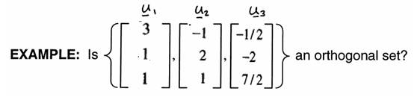
§6.2 Orthogonal Sets
1. Orthogonal Sets (正交集)
Definition：

Slide 33

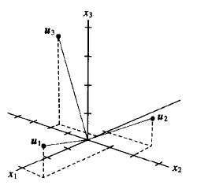

Slide 34
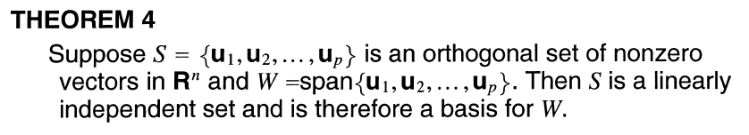
§6.2 Orthogonal Sets

Slide 35
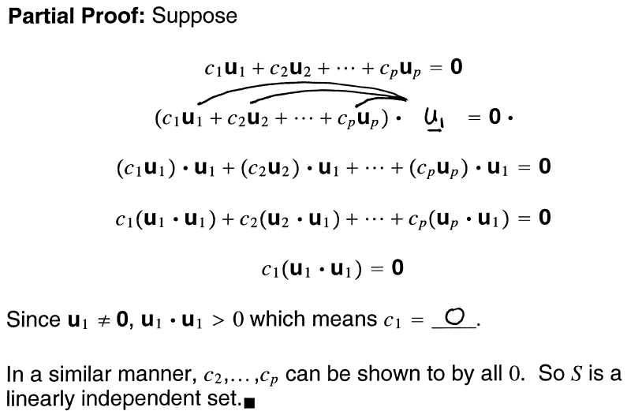

Slide 36
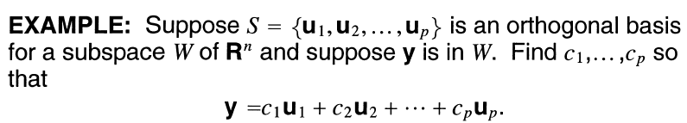
§6.2 Orthogonal Sets
Definition：

Slide 37

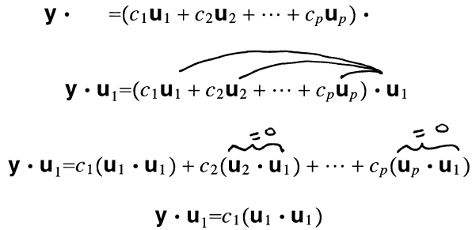



Slide 38
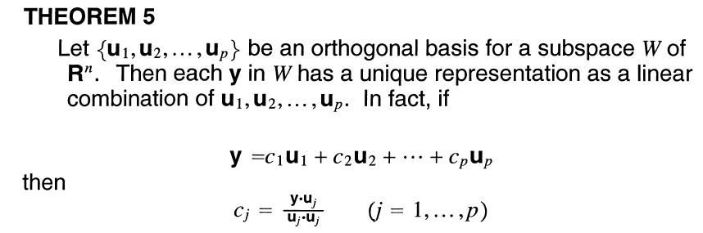
Proof：
As in the preceding proof, the orthogonality of {u₁, …, u_{p}} show that
y∙u₁= (c₁u₁ + c₂u₂ +…+ c_{p}u_{p})∙u₁ = c₁ (u₁ ∙u₁)
Since u₁∙u₁ is not zero, the equation above can be solved for c₁. To find c_{j} for j=2, … ,p, compute y∙u_{j} and solve c_{j}.

Slide 39
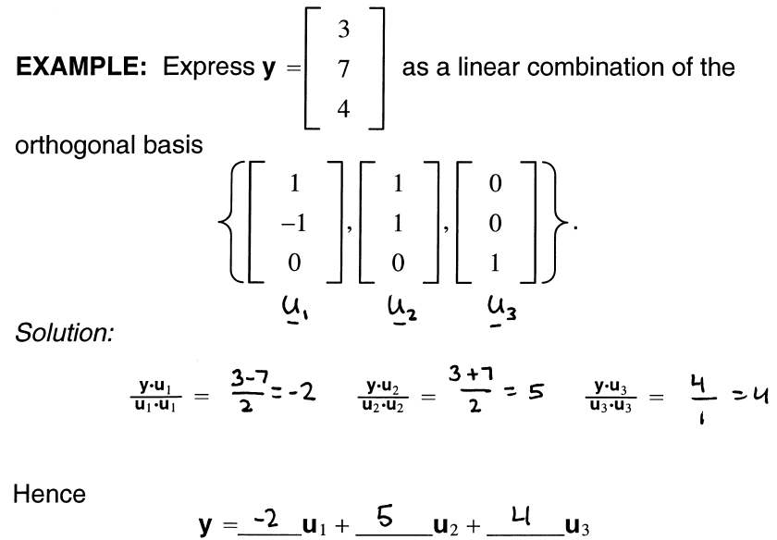

Slide 40

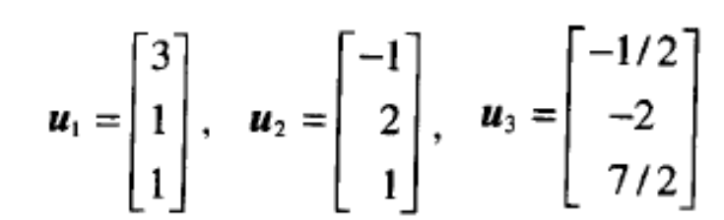
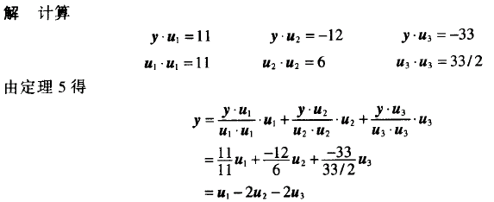
Example：The set S={u₁, u₂, u₃} in the above example is an orthogonal basis for R³
Express the vector as a linear combination of the vectors in S.
Solution：Compute
from Theorem 5,

Slide 41
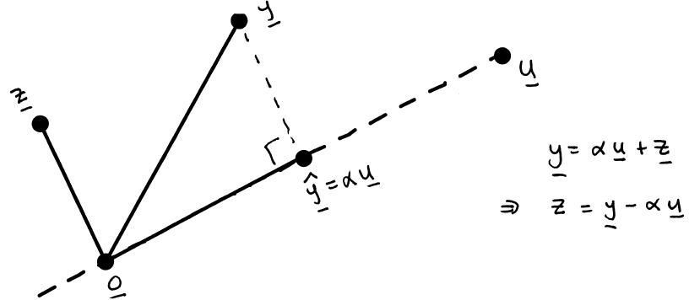
An Orthogonal Projection

Slide 42
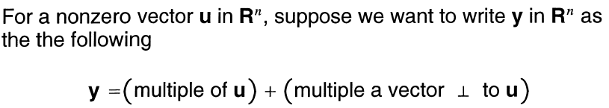
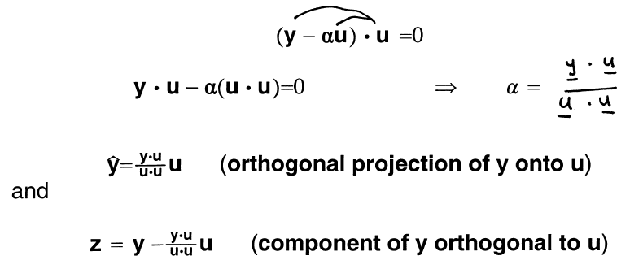
§6.2 Orthogonal Sets
2. An Orthogonal Projection

Slide 44
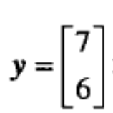





Example： let and . Find the orthogonal projection of y onto u. then write y as the sum of two orthogonal vectors, one in Span {u} and one orthogonal to u.
Solution: Compute
The orthogonal projection of y onto u is
And the component of y orthogonal to u is
The orthogonal projection of y onto u is

Slide 45



The decomposition of y is illustrated in the following Fig. Note: If the calculations above are correct, then will be an orthogonal set. As a check, compute：

Slide 46



§6.2 Orthogonal Sets
Example：Find the distance in Fig.3 from y to L.
Solution：The distance from y to L is the length of the perpendicular line segment from y to the orthogonal projection . This length equals the length of . Thus the distance is

Slide 47

§6.2 Orthogonal Sets
3. Orthonormal Sets (单位正交集)

Slide 48



§6.2 Orthogonal Sets

Slide 49



Example：Show that {v₁, v₂, v₃} is an orthognomal basis of R³,
where
Solution：Compute
Thus {v₁, v₂, v₃} is an orthogonal set. Also
Which shows that v₁, v₂, and v₃ are unit vectors. Thus {v₁, v₂, v₃} is an orthonormal set. Since the set is linearly independent, its three vectors from a basis for R³.

Slide 50

§6.2 Orthogonal Sets

Slide 51

§6.2 Orthogonal Sets

Slide 52





Example ：let
and
Notice that U has orthonormal
columns and
Verify that
Solution：

Slide 53
§6.3 Orthogonal Projections
1. Orthogonal Projection
2. Geometric Interpretation of the Orthogonal Projection
3. Properties of Orthogonal Projections

Slide 54



§6.3 Orthogonal Projections

Slide 55


§6.3 Orthogonal Projections

Slide 56







Slide 57

§6.3 Orthogonal Projections

Slide 58

§6.3 Orthogonal Projections

Slide 59





Slide 60



§6.3 Orthogonal Projections
Geometric Interpretation of Orthogonal Projections

Slide 61




Example: Let and Observe that {u₁,u₂} is an
orthogonal basis for W= Span{u₁, u₂}. Write y as the sum of a vector in W and a vector orthogonal to W.
Solution: The orthogonal projection of y onto W is
Also
The desired decomposition of y is

Slide 62


§6.3 Orthogonal Projections

Slide 63

§6.3 Orthogonal Projections

Slide 64



3
3
-1
-1
3
-1

Slide 65

§6.3 Orthogonal Projections

Slide 66

§6.3 Orthogonal Projections

Slide 67


§6.3 Orthogonal Projections

Slide 68
§6.4 The Gram – Schmidt Process
What is Gram – Schmidt Process?
Goal: Form an orthogonal basis for a subspace W.

Slide 69


So {v₁, v₂} is an orthogonal basis for W.

Slide 70


Slide 71

§6.4 The Gram – Schmidt Process

Slide 72

§6.4 The Gram – Schmidt Process

Slide 73

思路: 采用数学归纳法
Proof ：
Step1. For 1≤ k ≤p, let W_{k} = Span{x₁,…,x_{k}}. Set v₁ = x₁,
so that span{v₁} = Span{x₁}. Suppose, for some k< p, we have constructed v₁,…,v_{k} so that {v₁,…,v_{k}} is an orthogonal basis for W_{k}. Define

Slide 74
Step1. For 1≤ k ≤p, let W_{k} = Span{x₁,…,x_{k}}. Set v₁ = x₁,
so that span{v₁} = Span{x₁}. Suppose, for some k< p, we have constructed v₁,…,v_{k} so that {v₁,…,v_{k}} is an orthogonal basis for W_{k}. Define
Step2. By the Orthogonal Decomposition Theorem, v_{k+1} is orthogonal to W_{k}. Note that proj_{Wk} x_{k+1} is in W_{k} and hence also in W_{k+1}. Since x_{k+1} is in W_{k+1}, so is v_{k+1}.
Further more, v_{k+1}≠ 0 because x_{k+1} is not in W_{k} = Span{x₁,…,x_{k}}, hence {v₁,…,v_{k+1}} is an orthogonal set of nonzero vectors in the (k+1)-dimension space W_{k+1}. By the basis theorem in Section 4.5, this set is an orthogonal basis for W_{k+1}. Hence W_{k+1} = Span{v₁,…,v_{k+1}}. When k+1 = p, The process stop.

Slide 75

§4.5 The Dimension of a Vector Space

Slide 76

§6.4 The Gram – Schmidt Process
EXAMPLE Suppose {x₁,x₂,x₃}, where
is a basis for a subspace W of R⁴. Describe an orthogonal basis for W.

Slide 77



Slide 78


Slide 79


Slide 80





§6.4 The Gram – Schmidt Process
Orthonomal Basis (标准正交基)
Suppose the following is an orthogonal basis for subspace
Rescale to form unit vectors:

Slide 81

§6.4 The Gram – Schmidt Process
QR Factorization of Matrices

Slide 82


Proof ：The columns of A form a basis {x₁,…,x_{n}} for Col A. Construct an orthonormal basis {u₁,…,u_{n}} for W = Col A.
Let
For k = 1,…,n, x_{k} is in
So there are constants
Assume that . This shows that x_{k} is a linear
combination of the columns of Q using the entries in the
vector:
That is, Let Then

Slide 83




Slide 84


§6.5 Least – Squares Problems
Problem: What do we do when Ax = b has no solution x?

Slide 85



§6.5 Least – Squares Problems
Solution of the General Least-Squares Problem

Slide 86


Slide 87


§6.5 Least – Squares Problems

Slide 88


§6.5 Least – Squares Problems

Slide 89




Slide 90




Slide 91



Slide 92


§6.5 Least – Squares Problems
THEOREM 14

Slide 94


Slide 96


§6.5 Least – Squares Problems
Alternative Calculations of Least-Squares Solutions
Example：Find a least-squares solution of Ax = b for
Solution：Because the columns a₁ and a₂ of A are orthogonal, projection of b onto Col A is given by
(5)

Slide 97


Now that is known, we can solve . But this is trivial, since we are already know what weights to place on the columns of A to product . It is clear from (5) that

Slide 98




Theorem 15
Given an m*n matrix A with linearly independent columns, let A = QR be a QR factorization of A as in Theorem 12. Then, for each b in R^{m}, the equation Ax = b has a unique least-squares solution, given by
Proof： Let then
By Theorem 12, the columns of Q form an orthogonal basis for Col A. Hence, by Theorem 10, QQ^{T}b is the orthogonal projection of b onto Col A. Then , which shows that
is a least-squares solution of Ax=b.
The uniqueness of followings from Theorem 14.

